Slide 1


Chapter 5 Data Warehousing and Integration
Instructor: He Li
Notes:
In this chapter, we introduce the concept of data warehousing, why organizations need to develop such a data management strategy, data warehouse architecture, and dimensional modeling techniques.

Slide 2
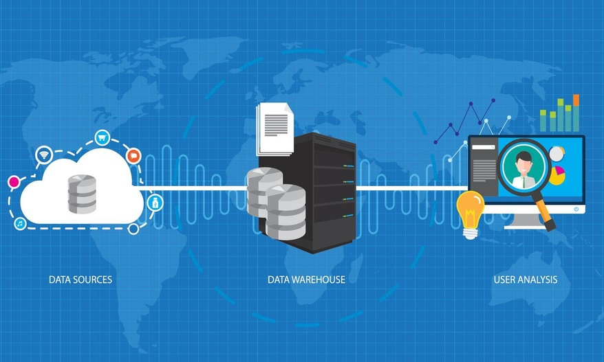
Data Warehouse
Definition: A subject-oriented, integrated, time-variant, non-updatable collection of data used in support of management decision-making processes
Why Data Warehousing?
Integrated, company-wide view of high-quality information (from disparate databases)
Separation of operational and informational systems and data (for improved performance)
Notes:
A data warehouse is a subject-oriented, integrated, time-variant, non-updateable collection of data used in support of management decision-making processes and business intelligence. The process of developing, maintaining, and using data warehouses to inform decision making is called data warehousing. Four major characteristics of a data warehouse:
Subject-oriented A data warehouse is organized around the key subjects of the enterprise, for example, customers, patients, students, products, and time.
Integrated Data in a data warehouse is defined using consistent naming conventions, formats, encoding structures, and related characteristics gathered from several internal systems of record and also often from external sources.
Time-variant Data in the data warehouse contain a time dimension so that they may be used to study trends and changes.
Non-updateable Data in the data warehouse are loaded and refreshed from operational systems but cannot be updated by end users.
Two major forces driving the need for data warehousing in organizations today. First, operational data and systems are fragmented and inconsistent, often in separate, incompatible silos. They may be distributed in several hardware and software platforms, with some running Oracle in a UNIX operating system, and another involving ERP products like SAP. But, for decision-making purposes, it is often necessary to provide a single, corporate view of that information.
Second, queries on data warehouses are often very complex, because of needing to deal with managerial needs. This requires significant computing resources. Operational systems should not need to compete for resources with data warehouses, so these should be separated. Also, as we’ll see, the data warehouse structure is different from an operational database, with much less need for normalization.

Slide 3
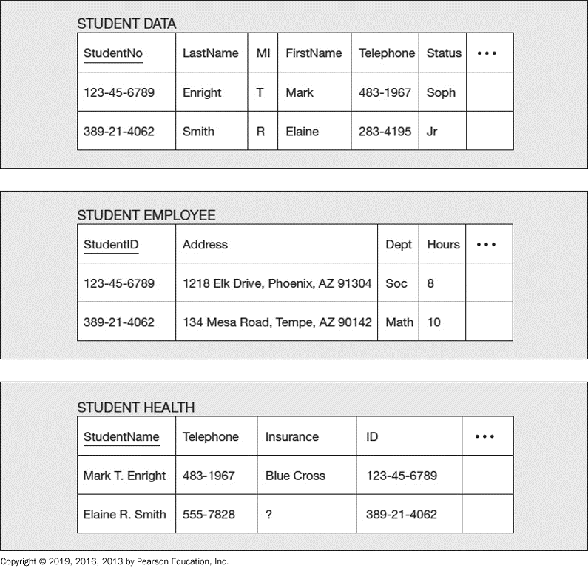
Difficulty of Deriving Company-Wide View
2. Synonym
3. Free-form vs structured fields
1. Inconsistent key structures
4. Inconsistent data values
5. Missing data
Notes:
Let’s look at this simple example to understand the difficulty of deriving a single corporate view. This figure shows three tables from three separate systems of record, each containing similar student data. The STUDENT DATA table is from the class registration system, the STUDENT EMPLOYEE table is from the personnel system, and the STUDENT HEALTH table is from a health center system.
Suppose we want to develop a profile for each student, consolidating all data into a single file format. Some of the issues that you must resolve are as follows:
Inconsistent key structures The primary key of the first two tables is some version of the student Social Security number, whereas the primary key of STUDENT HEALTH is StudentName.
Synonyms In STUDENT DATA, the primary key is named StudentNo, whereas in STUDENT EMPLOYEE it is named StudentID.
Free-form fields versus structured fields In STUDENT HEALTH, StudentName is a single field. In STUDENT DATA, StudentName (a composite attribute) is broken into its component parts: LastName, MI, and FirstName.
Inconsistent data values Elaine Smith has one telephone number in STUDENT DATA but a different number in STUDENT HEALTH. Is this an error, or does this person have two telephone numbers?
Missing data The value for Insurance is missing (or null) for Elaine Smith in the STUDENT HEALTH table. How will this value be located?
This simple example illustrates the nature of the problem of developing a single corporate view but fails to capture the complexity of that task. A real-life scenario would likely have dozens (if not hundreds) of files and thousands (or millions) of records.

Slide 4
Organizational Trends Motivating Data Warehouses
No single system of records
Multiple systems not synchronized
Supplier relationship management
Customer relationship management
Organizational need to analyze activities in a balanced way
Notes:
It is ironic that organizations spend so much time and effort to normalize a database, and yet often keep many different databases for different business purposes. This leads to the possibility of data duplication, which normalization was supposed to remove.
In general, certain trends in organizations encourage the need for data warehousing.
First, organizations often have several different database systems, because of the heterogeneous needs for data in different operational settings, corporate mergers and acquisitions, and the sheer size of many organizations.
Second, it is difficult, if not impossible, to make separate databases consistent. Even if the metadata are controlled and made the same by one data administrator, the data values for the same attributes will not agree.
Third, many organizations have implemented some form of a balanced scorecard—metrics that show organization results in financial, human, customer satisfaction, product quality, and other terms simultaneously. To ensure that this multidimensional view of the organization shows consistent results, a data warehouse is necessary.
Fourth, relating to the customer relationship management, having a total picture of the activity with a given customer requires a consolidation of data from various operational systems.
Fifth, data about supplier activities can be locked inside separate operational systems (e.g., accounts payable, shipping and receiving, production scheduling, and maintenance).

Slide 5
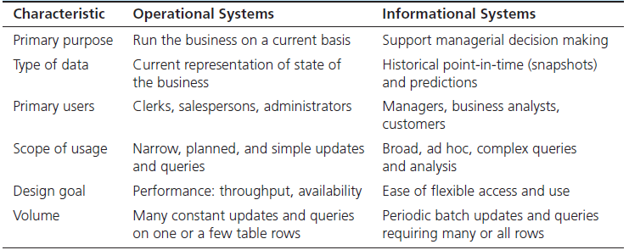
Operational System – a system that is used to run a business in real time, based on current data; also called a system of record
Informational System – a system designed to support decision making based on historical point-in-time and prediction data for complex queries or data-mining applications
Notes:
In the first chapter when we introduce the framework of data management, we mentioned that it is important to distinguish operational versus information systems. An operational system is a system that is used to run a business in real time, based on current data. Examples of operational systems are sales order processing, reservation systems, and patient registration systems.
Informational systems are designed to support decision making based on historical point-in-time and prediction data. They are also designed for complex queries or data-mining applications. Examples of informational systems are systems for sales trend analysis, customer segmentation, and human resources planning.
This table further summarizes the key differences between operational and informational systems.
The data warehouse is an informational system aiming at assisting with managerial decision-making. This is different from the purpose of operational systems or transaction-oriented database, which is to support and record the day-to-day operations and transactions of a business. The data produced in transaction-oriented databases forms much of the input for a data warehouse.
Operational databases are often called online transaction processing (OLTP) databases, whereas data warehouses are associated with online analytical processing (OLAP) systems.

Slide 6
A Generic Data Warehousing Framework
Notes:
Many organizations need to create data warehouses—massive data stores of time-series data for decision support. Data are imported from various external and internal sources and are cleansed and organized in a manner consistent with the organization’s needs. After the data are populated in the data warehouse, data marts can be loaded for a specific area or department. Alternatively, data marts can be created first, as needed, and then integrated into an enterprise DW. Often, though, data marts are not developed, but data are simply loaded onto PCs or left in their original state for direct manipulation using BI tools. This figure illustrates this data warehousing process. Major components include data source, ETL process, Enterprise DW, data marts, metadata, middleware tools, and BI applications.

Slide 7
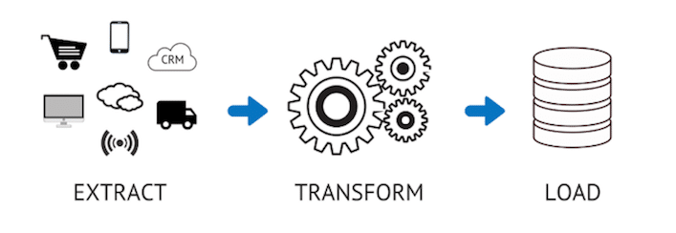
ETL – Data Integration for Data Warehousing
reading data from one or more sources (e.g. OLTP databases, personal databases, spreadsheets)
converting the extracted data into the appropriate form, cleaning data
putting the data into the data warehouse
Notes:
At the heart of the technical side of the data warehousing process is ETL.
Capturing the relevant data from the source files and databases used to fill the EDW is typically called extracting.
Then, we convert the extracted data into appropriate form and clean the data. Cleaning data is a very important step. Some activities include consistent data names and definitions, correct errors, missing data, mismatched data, remove duplicate data, and resolve different primary keys across sources. This stage of transformation also includes formatting, aggregating and merging, and enrichment.
The third step is load, where we put the data into the data warehouse.

Slide 8
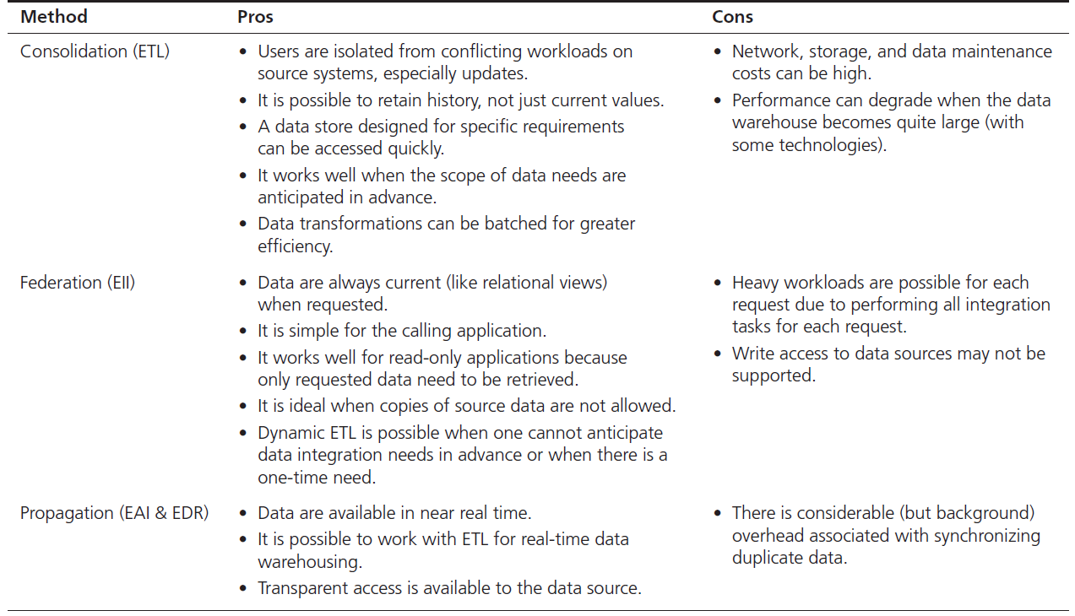
Data Integration creating a unified view of business data
Notes:
What ETL does essentially is the data integration. In other words, data comes from a wide variety of data sources and are combined into the data warehouses. These data sources can be databases, spreadsheet files, XML sources, Web services, legacy files, or other types of data. Note that data also can be consolidated across an enterprise in other ways such as application integration, business process integration, and user interaction integration.
Three techniques form the building blocks of any data integration approach: data consolidation, data federation, and data propagation.
ETL stands for extract-transform-load. This is the traditional approach for building physical data warehouses. It consolidates all data into a centralized database (like a data warehouse).
EII stands for enterprise information integration. In this case there is no physical data warehouse; rather the data warehouse is “virtual”, composed of dynamic queries and views that operate directly on the source data.
EAI stands for enterprise application integration, and EDR stands for enterprise data replication. In both cases, data are pushed to duplicate sites as updates occur. Sometimes this is called event-driven propagation; the events are the updates themselves.
In this chapter, we focus on the data warehouse approach – ETL for data integration. It is notable that other approaches share a lot of similarities with the ETL approach.

Slide 9
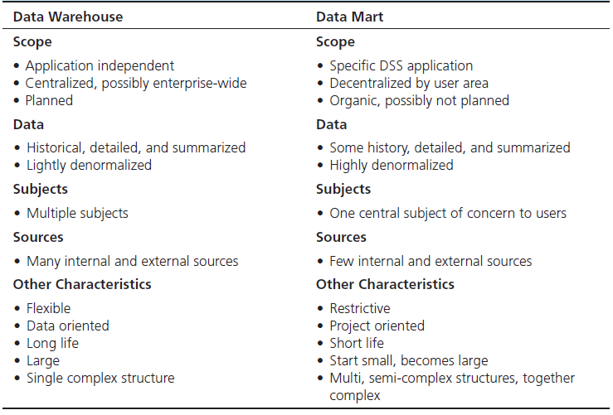
Data Warehouse v.s. Data Mart
Notes:
An enterprise data warehouse is a centralized, integrated data warehouse that is the control point and single source of all data made available to end users for decision support applications. A data mart is a data warehouse that is limited in scope, customized for the decision-making applications of a particular end-user group.
Data marts and data warehouses play different roles in a data warehousing environment, as summarized in this table. Although limited in scope, a data mart may not be small.

Slide 10
Data Warehouse Development
Inmon Model: EDW Approach (Top-Down)
Kimball Model: Data Mart Approach (Bottom-Up)
Provides a highly consistent dimensional view of data across data marts as all data marts are loaded from the centralized repository (Data Warehouse).
Flexible to support business changes as it looks at the organization as whole.
Generating a new data mart against the data stored in the data warehouse relatively simple.
Large-scale and scope of project
Up-front cost
Long duration; may be inflexible and unresponsive to changing business needs during implementation
Emphasizes the value of the data warehouse to business users as quickly as possible.
Focuses on each individual business process -> quick return on investment
May lack the big picture of the enterprise data warehouse by missing some dimensions or by creating redundant dimensions
Lower cost
Fairly simple
Notes:
Accordingly, there are two approaches for developing a data warehouse. Inmon’s EDW approach is often regarded as a top-down approach, which emphasizes on the development of enterprise wide centralized data warehouse. This approach supports business changes better and can easily generate data marts; however, it is often in larger-scale, higher up-front costs, and longer duration.
Reversely, Kimball’s approach, known as a bottom-up approach, starts from building data marts that satisfies business users as quickly as possibly. Although it has lower costs and is fairly simple in implementation, this approach may lack the big picture of the enterprise data warehouse.

Slide 11
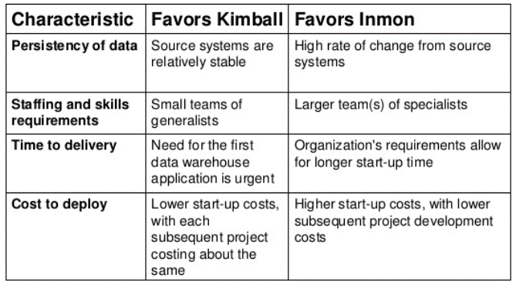
Choosing Data Warehouse Development Approach
Notes:
So, both Kimball and Inmon approaches have their advantages and disadvantages. Organizations can select the most appropriate approach depending on their unique business situations. For example, when the time to delivery of a data warehouse is emergent, the organization can pursue a Kimball’s bottom-up approach.

Slide 12
Alternative DW Architectures
Notes:
At the highest level, data warehouse architecture design viewpoints can be categorized into enterprise DW design and data mart design. However, there are some alternatives to the basic architectural design types that are neither pure EDW nor pure DM, but in between or beyond the traditional architectural structures.
Independent Data Marts. This is arguably the simplest and the least costly architecture alternative. The data marts are developed to operate independently of each another to serve the needs of individual organizational units. Because of their independence, they may have inconsistent data definitions and different dimensions and measures, making it difficult to analyze data across the data marts.
(An independent data marts is a data mart filled with data extracted from the operational environment, without the benefit of a data warehouse. In contrary, the data mart filled exclusively from an enterprise data warehouse and its reconciled data refers to a dependent data mart.)
Data Mart Bus Architecture. This is a viable alternative to the independent data marts where the individual marts are linked to each other via some kind of middleware. Because the data are linked among the individual marts, there is a better chance of maintaining data consistency across the enterprise (at least at the metadata level). Even though it allows for complex data queries across data marts, the performance of these types of analysis may not be at a satisfactory level.
Hub-and-Spoke Architecture. This is perhaps the most famous data warehousing architecture today. Here the attention is focused on building a scalable and maintainable infrastructure that includes a centralized data warehouse and several dependent data marts. This architecture allows for easy customization of user interfaces and reports. On the negative side, this architecture lacks the holistic enterprise view, and may lead to data redundancy and data latency.

Slide 13
Alternative DW Architectures (cont.)
Each architecture has advantages and disadvantages!
Notes:
Centralized Data Warehouse Architecture. The centralized data warehouse architecture is similar to the hub-and-spoke architecture except that there are no dependent data marts; instead, there is an enterprise data warehouse that serves the needs of all organizational units. This centralized approach provides users with access to all data in the data warehouse instead of limiting them to data marts. In addition, it reduces the amount of data the technical team has to transfer or change, therefore simplifying data management and administration. If designed and implemented properly, this architecture provides a timely and holistic view of the enterprise to whomever, whenever, and wherever they may be within the organization.
Federated Architecture. The federated approach is a concession to the natural forces that undermine the best plans for developing a perfect system. It uses all possible means to integrate analytical resources from multiple sources to meet changing needs or business conditions. Essentially, the federated approach involves integrating disparate systems. In a federated architecture, existing decision support structures are left in place, and data are accessed from those sources as needed.
Overall, each architecture has its advantages and disadvantages. Organizations need to select the “best” architecture based on their situations, such as information needs, urgency of need for a data warehouse, organizational enterprise architecture, nature of end-user tasks, constraints on resources, technical abilities and issues, and social/political factors.

Slide 14
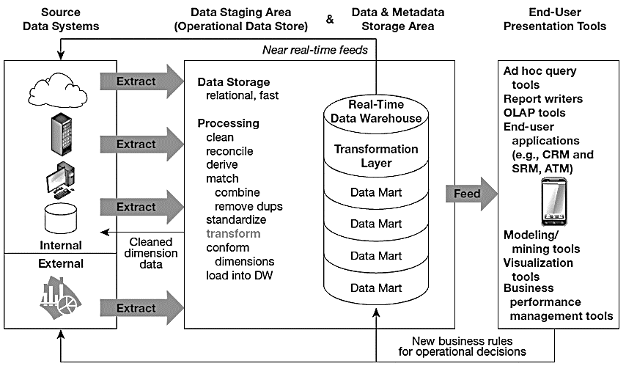
Logical Data Mart and Real-time Data Warehouse Architecture
Notes:
Real-time data warehouse is an enterprise data warehouse that accepts near-real-time feeds of transactional data from the systems of record, analyzes warehouse data, and in near-real-time relays business rules to the data warehouse and systems of record so that immediate action can be taken in response to business events.
An example of real-time data warehousing (with real-time analytics) would be an express mail and package delivery service using frequent scanning of parcels to know exactly where a package is in its transportation system. Real-time analytics, based on this package data, as well as pricing, customer service–level agreements, and logistics opportunities, could automatically reroute packages to meet delivery promises for their best customers. RFID technologies are allowing these kinds of opportunities for real-time data warehousing (with massive amounts of data) coupled with real-time analytics to be used to greatly reduce the latency between event data capture and appropriate actions being taken.

Slide 15
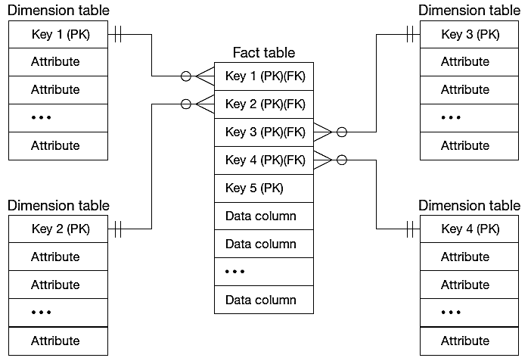
Dimensional Modeling: Star Schema
A simple database design in which dimensional data are separated from fact or event data.
Notes:
Various conceptual data models or schemas can be used to design a data warehouse, which all involve the modeling of facts, as well as dimensions with which to analyze these facts. A star schema is a simple database design in which dimensional data are separated from fact or event data. Another name for star schema is “dimensional model”.
Note that the fact table is in essence an associative entity that joins various dimension tables. The dimension tables are usually the source of attributes used to qualify, categorize, or summarize facts in queries, reports, or graphs; thus, dimension data are usually textual and discrete.
Fact tables contain factual or quantitative data (measurements that are numerical, continuously valued, and additive) about a business, such as units sold, orders booked, and so on.
Dimension tables are denormalized to maximize performance. The 1:N relationship between dimension tables and fact tables means you can think of fact tables as associative entities between dimensions.

Slide 16
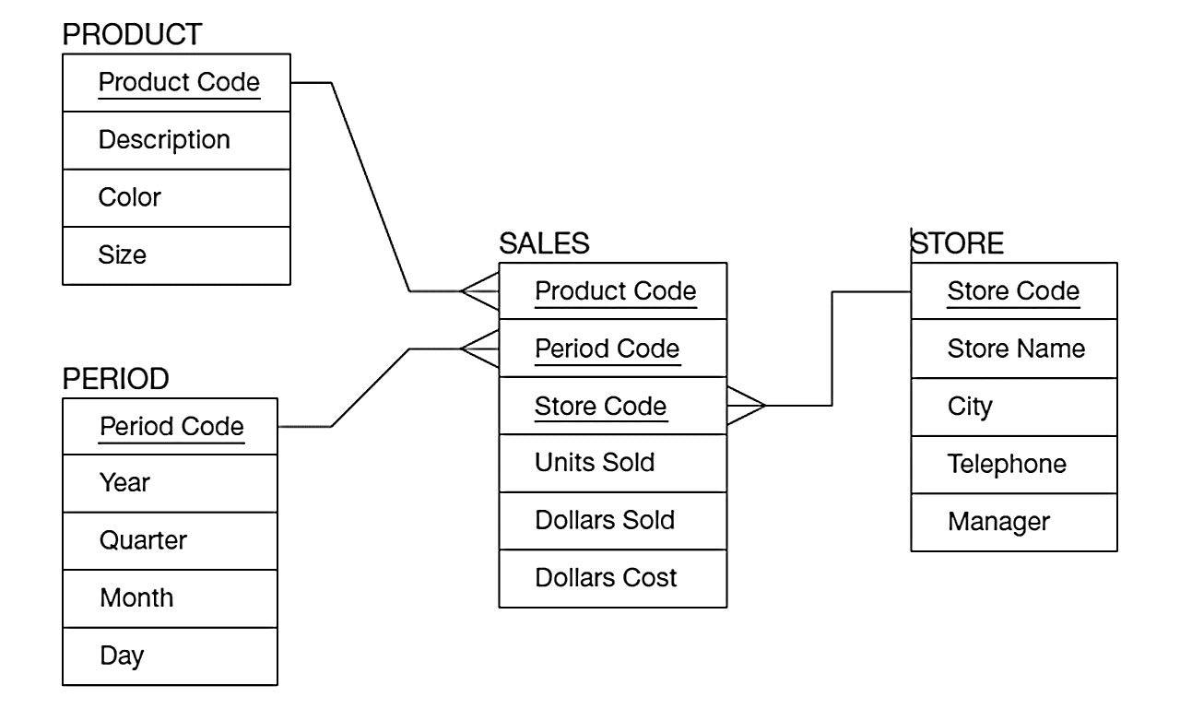
Example: Star Schema
Fact table provides statistics for sales broken down by product, period, and store dimensions
Notes:
Here we have a fact table surrounded by three dimension tables. Each fact shows sales data for a particular product from a particular store during a particular time period. The data in the fact table was likely derived from the operational database’s sales data. Note that this is summary data. The operational database has records of each sale, but here we are getting summary data (units sold, dollars sold, dollars cost). This is typical in data warehouses, and has to do with another concept we will soon discuss, the concept of “granularity”.

Slide 17
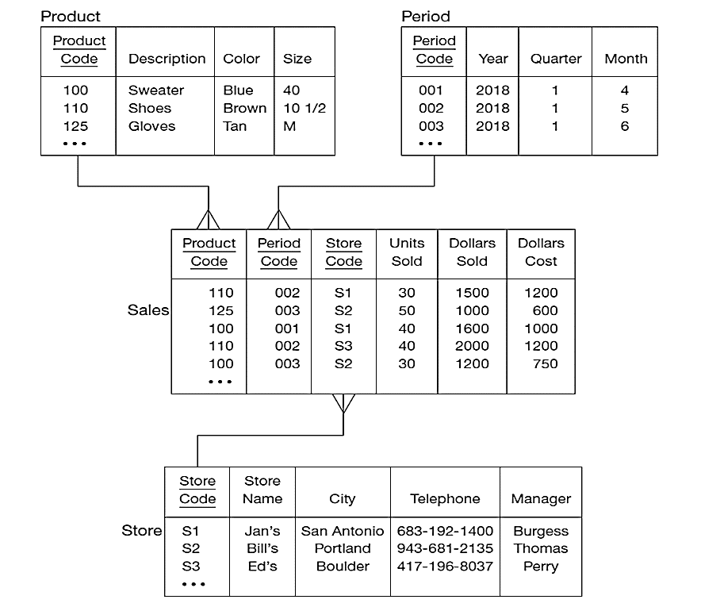
Example: Star Schema
Notes:
This is the same star schema showing the data. Notice that the fact table has numeric data and foreign keys. The dimension tables have primary keys and discrete data. We can use this to answer many managerial questions. For example:
Question: What can you say about unit sales for store S2?
Answer: 50 units of product 125 (gloves) and 30 units of product 100 (sweaters) were sold in June 2018.
Question: Which store(s) sold shoes and when?
Answer: S1 (Jan’s) and S3 (Ed’s), both in May 2018.
Question: Which time period has the most total dollars sold?
Answer: Time period 002 (May 2018) has the most, with a total of $3500.

Slide 18
Specific Issues
Surrogate Key: dimension table keys should be surrogate (non-intelligent and non-business related);
Granularity of Fact Table: What level of detail do you want?
Transactional grain – finest level
Aggregated grain – more summarized
Finer grains brings better market basket analysis capability
Finer grain implies more dimension tables, more rows in fact table
In Web-based commerce, finest granularity is a click
Duration of the Database
Natural duration – 13 months or 5 quarters
Financial institutions may need longer duration
Older data is more difficult to source and cleanse
Notes:
We elaborate on some specific schema issues.
Every key used to join the fact table with a dimension table should be a surrogate (nonintelligent, or system-assigned) key, not a key that uses a business value (sometimes called a natural, smart, or production key), because 1. business keys may change over time; 2. it helps keep track of non-key attribute values for a given production key; 3. surrogate keys are simpler and shorter; and 4. surrogate keys can be same length and format for all keys.
The terms “grain” or “granularity” refer to the level of detail in a fact table, determined by the intersection of all the components of the primary key, including all foreign keys and any other primary key elements. Kimball and others recommend using the smallest grain possible, given the limitations of the data mart technology. Even when data mart user information requirements imply a certain level of aggregated grain, often after some use, users ask more detailed questions (drill down) as a way to explain why certain aggregated patterns exist. You cannot “drill down” below the grain of the fact tables. But, fine grain means higher volume of data.
As in the case of the EDW, another important decision in the design of a data mart is the amount of history to be kept, that is, the duration of the database. The natural duration is about 13 months or 5 calendar quarters, which is sufficient to see annual cycles in the data. Some businesses, such as financial institutions, have a need for longer durations. Older data may be difficult to source and cleanse if additional attributes are required from data sources. Even if sources of old data are available, it may be most difficult to find old values of dimension data, which are less likely than fact data to have been retained. Old fact data without associated dimension data at the time of the fact may be worthless.

Slide 19
Specific Issues – size of fact table
Depends on number of dimensions and grain of the fact table
Number of rows = product of number of possible values for each dimension associated with the fact table
Example: Assume the following:
Total number of stores = 1,000
Total number of products = 5,000
Total number of periods = 24 (two years’ worth of monthly data)
Total rows calculated as follows:
Total rows = 1,000 stores × 5,000 active products × 24 months = 120,000,000 rows
Notes:
As you would expect, the grain and duration of the fact table have a direct impact on the size of that table. We can estimate the number of rows in the fact table using the product of number of possible values for each dimension associated with the fact table.
Here is an example. Assume that total number of stores is 1000, total number of products is 5,000, and total number of periods is 24. Then the total rows will be 1,000 stores × 5,000 active products × 24 months = 120,000,000 rows.
Many large retailers (e.g., Walmart, Kmart, Sears) and e-businesses (e.g., Amazon) now have data warehouses (or data marts). The size of most of these data warehouses is in the multiple-terabyte range and growing rapidly as marketing people continue to press for more dimensions and an ever-finer grain in the fact table.

Slide 20
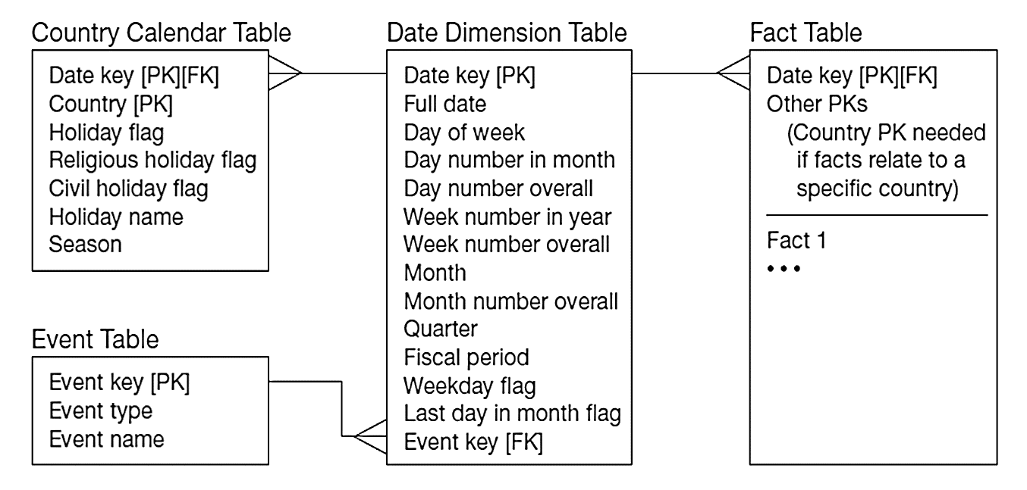
Specific Issues – modeling dates
Fact tables contain time-period data, so date dimensions are important.
Notes:
Because data warehouses and data marts record facts about dimensions over time, date and time is always a dimension table, and a date surrogate key is always one of the components of the primary key of any fact table. This is one of the reasons we consider data warehouses to be time-variant.
Note that the Date dimension table includes many non-key attributes, as you see here. The non-key attributes include all of the characteristics of dates that users use to categorize, summarize, and group facts.
Question: In this model, what can you say about how many events could be associated with a particular date?
Answer: Only one! That may be a weakness in the model.

Slide 21
Snowflake Schema – Normalizing Dimension Tables
Multivalued Dimensions
Facts qualified by a set of values for the same business subject
Normalization involves creating a table for an associative entity between dimensions
Hierarchies
Sometimes a dimension forms a natural, fixed-depth hierarchy
Design options
Include all information for each level in a single denormalized table
Normalize the dimension into a nested set of 1:N table relationships
Notes:
Although fact tables are normalized, often dimension tables may not be. This enables dimension tables to be only one join away from the fact table, improving query performance. Of course, non-normalized data involves data duplication.
Question: Why is this not a problem?
Answer: Because the data warehouse is not volatile. Data doesn’t change like a transaction processing database.
Different from the star schema, snowflake schema normalizes the dimensional table. There are two difference cases: multivalued dimensions and hierarchies. Let’s look at two examples illustrating them.

Slide 22
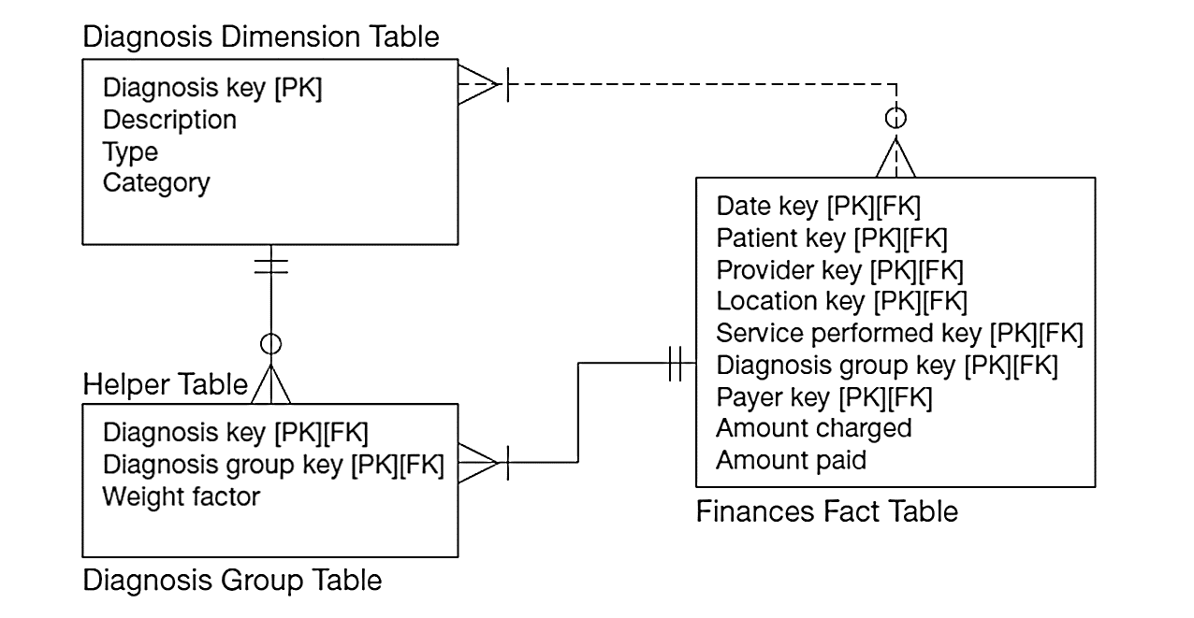
Example: Normalizing Multivalued Dimensional Tables
A helper table is an associative entity that implements a M:N relationship between dimension and fact.
Notes:
Although fact tables are usually on the many side of a 1:N relationship with their associated dimensions, there are circumstances where facts may need to have M:N relationships. In a data warehouse, this is facilitated through the use of a “helper” table, which is an associative entity between the fact and the dimension.

Slide 23
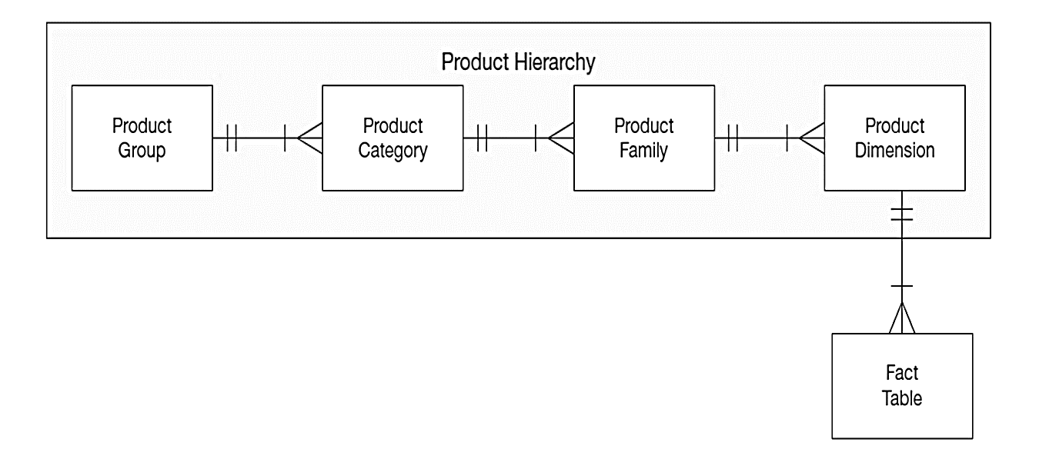
Example: Normalizing Dimensional Table Using Hierarchy
Dimension hierarchies help to provide levels of aggregation for users wanting summary information in a data warehouse.
Notes:
In this figure, we see the hierarchy implemented through normalized dimension tables. This prevents duplication of product groups, categories, and families. But a query for a fact that required the product group would need to involve five tables in the join.
But, it could also have been implemented as a single Product dimension table, with all the other data (group, category, family) included. In this case there would be data duplication, but the queries would be simplified, requiring only two tables in the join.

Slide 24
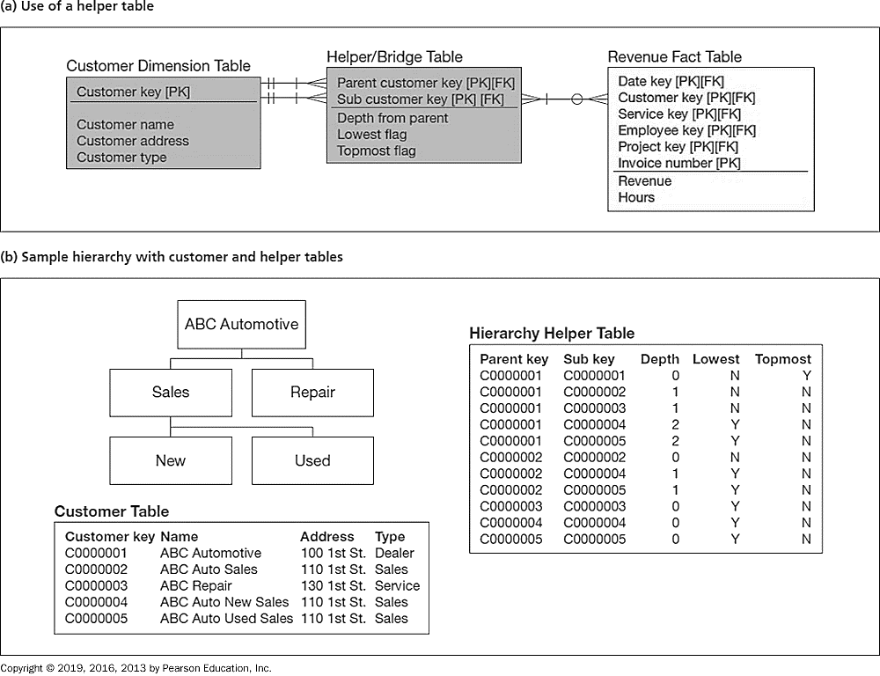
Example: Representing Hierarchical Relationships within a Dimension
Notes:
Another simple but more general alternative appears in this Figure. Figure (a) shows how this hierarchy is typically modeled in a data warehouse using a helper table. The problem with joining in a recursive relationship of arbitrary depth is that the user has to write code to join an arbitrary number of times (once for each level of subordination) and these joins in a data warehouse, because of its massive size, can be very time-consuming (except for some high-performance data warehouse technologies that use parallel processing). To avoid this problem, the helper table flattens out the hierarchy by recording a row for each organizational subunit and each of its parent organizational units (including itself) all the way up to the top unit of the customer organization. Figure (b) depicts an example customer organizational hierarchy and the rows that would be in the helper table to represent that total organization.

Slide 25
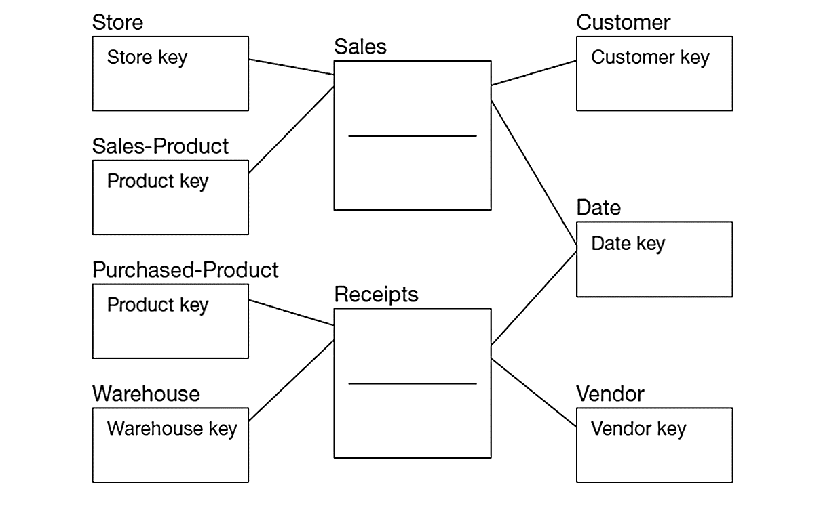
Multiple Fact Tables
Two fact tables connect two star schemas. Conformed dimension is associated with multiple fact tables.
Notes:
Here we see a typical situation of multiple fact tables with two related star schemas. In this example, there are two fact tables, one at the center of each star:
Sales — facts about the sale of a product to a customer in a store on a date
Receipts — facts about the receipt of a product from a vendor to a warehouse on a date
These two star schemas are connected via a common dimension (Date). The term for this is a “conformed dimension”. Conformed dimensions are dimension tables associated with two or more fact tables for which the dimension tables have the same business meaning and primary key with each fact table.

Slide 26
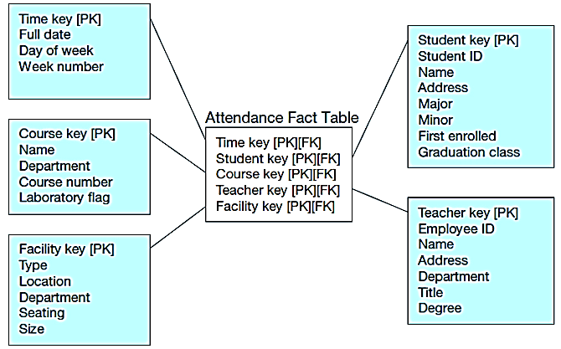
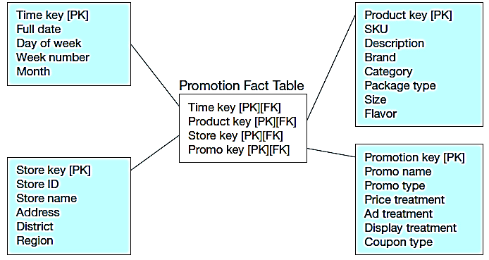
Factless Fact Table
No data in fact table, just keys associating dimension records. Fact table forms an n-ary relationship between dimensions
Factless fact table showing occurrence of an event
Factless fact table showing coverage
Notes:
As strange as it may seem, there are applications for fact tables that do not have nonkey (fact) data but do have foreign keys for the associated dimensions.
The two general situations in which factless fact tables may apply are tracking events (see Figure a) and taking inventory of the set of possible occurrences (called coverage) (see Figure b).
As shown in the upper figure, the star schema tracks which students attend which courses at which time in which facilities with which instructors. All that needs to be known is whether this event occurs, represented by the intersection of the five foreign keys.
The bottom figure shows the set of possible sales of a product in a store at a particular time under a given promotion.

Slide 27
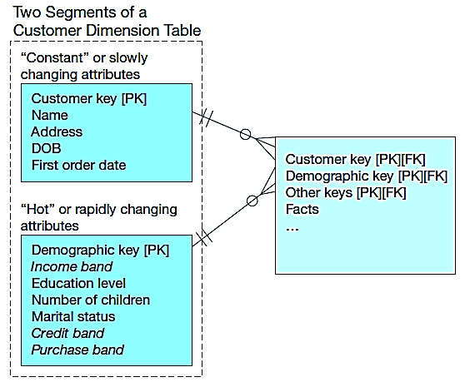
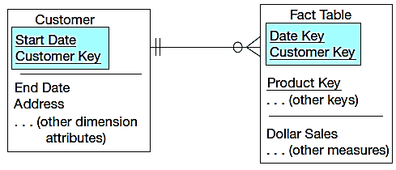
Slowly Changing Dimensions (optional) How to maintain knowledge of the past?
Kimball’s approaches:
Type 1: just replace old data with new (lose historical data)
Type 2: for each changing attribute, create a current value field and several old-valued fields (multivalued)
Type 3: create a new dimension table row each time the dimension object changes, with all dimension characteristics at the time of change — most common approach
(a) Example of Type 3
(b) Dimension Segmentation
Notes:
This page is optional for students.
Recall that data warehouses and data marts track business activities over time, often for many years. The business does not remain static over time; products change size and weight, customers relocate, stores change layouts, and sales staff are assigned to different locations. in a data warehouse or data mart, we need to know the history of values to match the history of facts with the correct dimensional descriptions at the time the facts happened. For example, we need to associate a sales fact with the description of the associated customer during the time period of the sales fact, which may not be the description of that customer today. Of course, business subjects change slowly compared with most transactional data (e.g., inventory level). Thus, dimensional data change, but change slowly.
We might handle slowly changing dimension (SCD) attributes in one of three ways (Kimball, 1996b, 1999):
First, overwrite the current value with the new value, but this is unacceptable because it eliminates the description of the past that we need to interpret historical facts.
Second, for each dimension attribute that changes, create a current value field and as many old value fields as we wish. This schema might work if there were a predictable number of changes over the length of history retained in the data warehouse (e.g., if we need to keep only 24 months of history and an attribute changes value monthly). However, this works only under this kind of restrictive assumption and cannot be generalized to any slowly changing dimension attribute. Further, queries can become quite complex because which column is needed may have to be determined within the query.
Third, create a new dimension table row (with a new surrogate key) each time the dimension object changes; this new row contains all the dimension characteristics at the time of the change; the new surrogate key is the original surrogate key plus the start date for the period when these dimension values are in effect.
Figure (a) shows an example of this most popular approach. However, this schema can cause an excessive number of dimension table rows when dimension objects frequently change or when dimension rows are large “monster dimensions.” Also, if only a small portion of the dimension row has changing values, there are excessive redundant data created.
Figure (b) illustrates one approach, dimension segmentation, which handles this situation as well as the more general case of subsets of dimension attributes that change at different frequencies. In this example, the Customer dimension is segmented into two dimension tables; one segment may hold nearly constant or very slowly changing dimensions and other segments (we show
only two in this example) hold clusters of attributes that change more rapidly and, for attributes in the same cluster, often change at the same time. These more rapidly changing attributes are often called “hot” attributes by data warehouse designers.

Slide 28
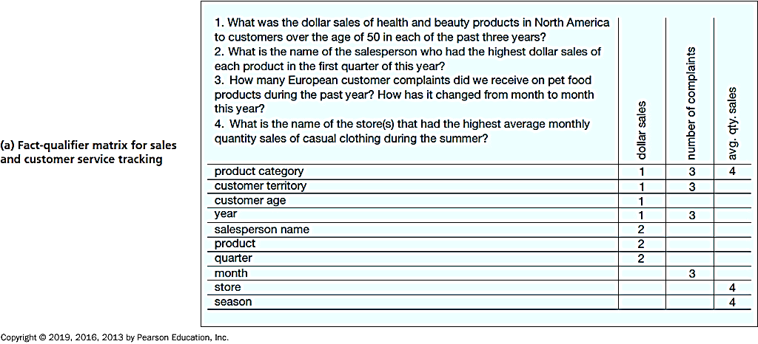
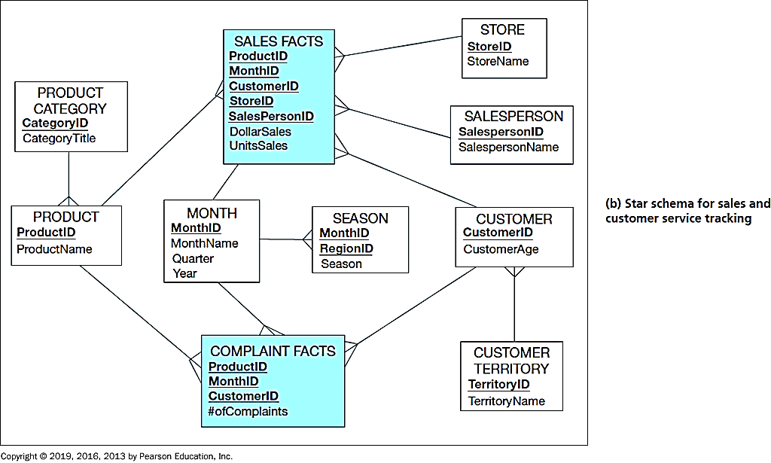
Determining Dimensions and Facts
(a) fact-qualifier matrix for sales and customer service tracking
(b) Star schema for sales and customer service tracking
Notes:
Which dimensions and facts are required for a data mart is driven by the context for decision making. The starting point for determining what data should be in a data mart are the initial questions the users want answered. Each question can be broken down into discrete items of business information the user wants to know (facts) and the criteria used to access, sort, group, summarize, and present the facts (dimension attributes).
Here, we look at one example. We first develop a matrix as shown in the left side figure. In this figure, the rows are the qualifiers (dimension or dimension attributes) and the columns are the metrics (facts) referenced in the questions. The cells of the matrix contain codes to indicate which qualifiers and metrics are included in each question. For example, question 3 uses the fact number of complaints and the dimension attributes of product category, customer territory, year, and month. One or several star schemas may be required for any set of questions. For the example in Figure a, we have designed two fact tables, shown in Figure b because the grain of the facts are different (e.g., we determined complaints have nothing to do with stores or salespersons). We also created hierarchical relationships between product and product category and between customer and customer territory; alternatively it would have been possible, for example, to collapse product category into product, with resulting redundancy. We also understood season as a separate concept from month, and to be territory dependent. Product, Customer, and Month are conformed dimensions because they are shared by two fact tables.

Slide 29
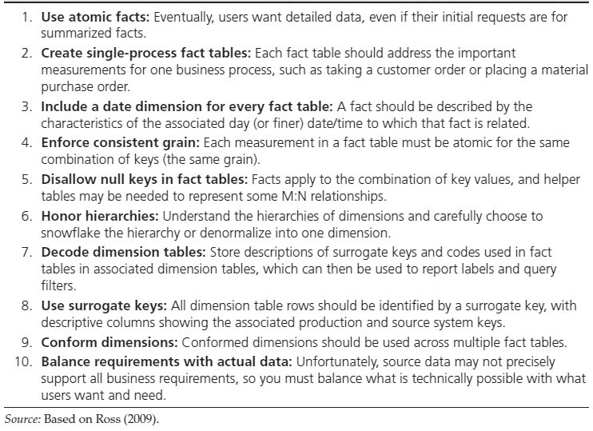
10 Essential Rules for Dimensional Modeling
Notes:
So, if the type of analysis depicted in above represents the starting point for determining the dimensions and facts of a dimensional model, when do you know you are done? Ross (2009) has identified what the consulting practice for Ralph Kimball and Kimball University considers to be the 10 essential rules of dimensional modeling. We summarize these rules in this Table; we think you will find these rules to be a helpful synthesis of many principles outlined in this chapter. When these rules are satisfied, you are done (for the time being).

Slide 30
The Process of Data Analysis
Accessing data sources
Combining tables
Transforming variables and cleaning data
Exploring and describing data
Visualizing patterns in the data
Analyzing and modeling data

Slide 31
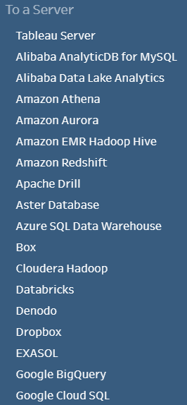
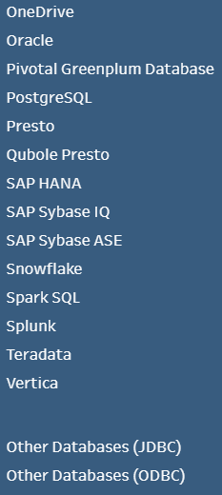
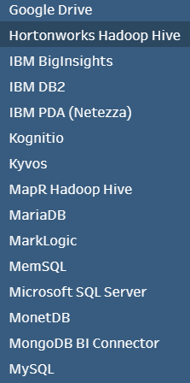
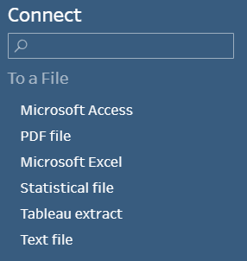
Common Data Formats
Tableau Prep can read and use data from a variety of different formats.

Slide 32
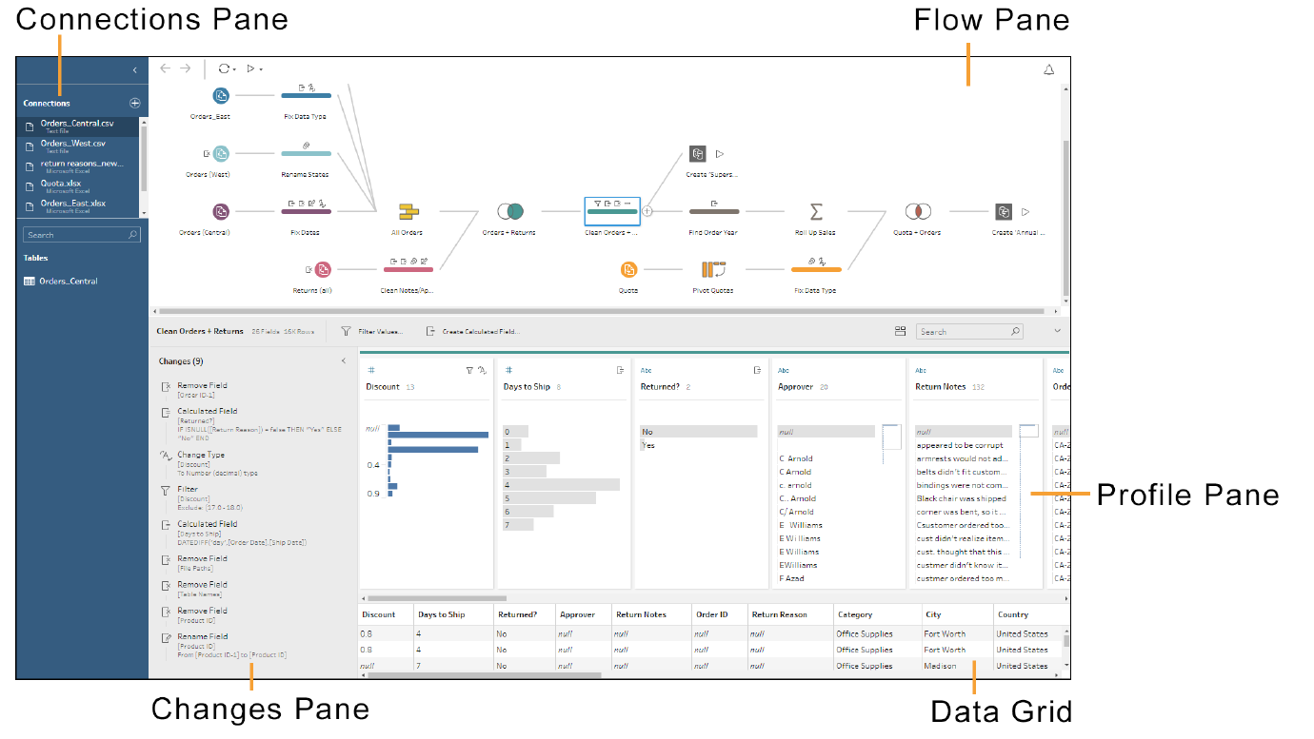
The Tableau Prep Workspace
add connections to data
Notes:
The Tableau Prep workspace consists of the Connections pane to connect to data, and three panes that work together to provide visibility into your data preparation.
The Connections pane on the left side of the workspace shows the data connections.
The + icon allows you to add connections to data.
The databases and files you are connected to are listed.
The tables you can work with in the flow pane are shown.
You can minimize the Connections pane by using the < icon
The flow pane at the top of the workspace is a visual representation of the steps that are created as you prepare your data.
There are different types of steps used in a flow to clean, shape, combine, and output your data.
When you click on a particular step, the profile pane and the data grid show details for the data at that point in the flow.
The profile pane in the middle of the workspace shows the structure of your data for that step in the flow.
The profile pane shows a summary of the fields in your data sample.
A histogram shows the data distribution of each field to help you quickly find nulls and outliers.
The toolbar and the context menus for each field show the operations you can perform during that step in the flow.
The contents of the profile pane will vary depending on what type of operation you are on in the flow.
You can minimize the profile pane using the √ icon.
As you clean your data, the operations you perform are listed in the Changes pane within the profile pane.
You can show the Changes pane using the > icon in a cleaning step.
All cleaning operations are recorded.
Click on a particular change to see the details about that operation at that point in the flow.
The data grid at the bottom of the workspace shows the row level detail for your data at that step in the flow. The data in the data grid reflects the selections in the profile pane.

Slide 33
The Tableau Prep Workspace
Notes:
When an input is selected in the flow pane, the profile pane becomes the Input pane. Here, you can view and edit input settings and fields.

Slide 34
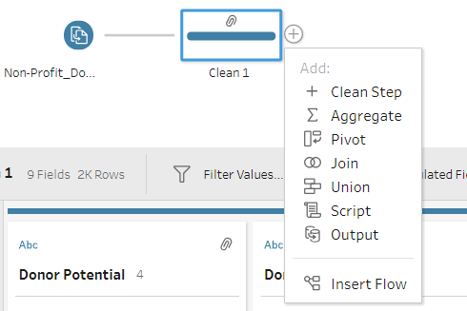
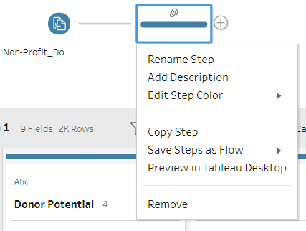
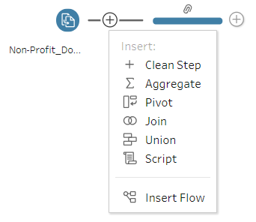
Types of Steps in Tableau Prep
add a new step
Right Click
rename, add description, copy, remove …
Notes:
The flow pane shows you all the data preparation steps that you applied to your data. Each step in your data preparation process is represented visually in the flow that you create and control.
To add a new step, click the + icon to the right of any step.
You can rename any step in the flow to be more descriptive.
You can also write a description for the step by right-clicking on a step and then clicking Add Description.
You can insert and remove a step in a flow.
You can disconnect and reconnect steps in a flow.
A branch can be used to split a flow.
Use an output step to save or publish your cleaned data.
You can save your flow and open it later to add or edit steps.

Slide 35
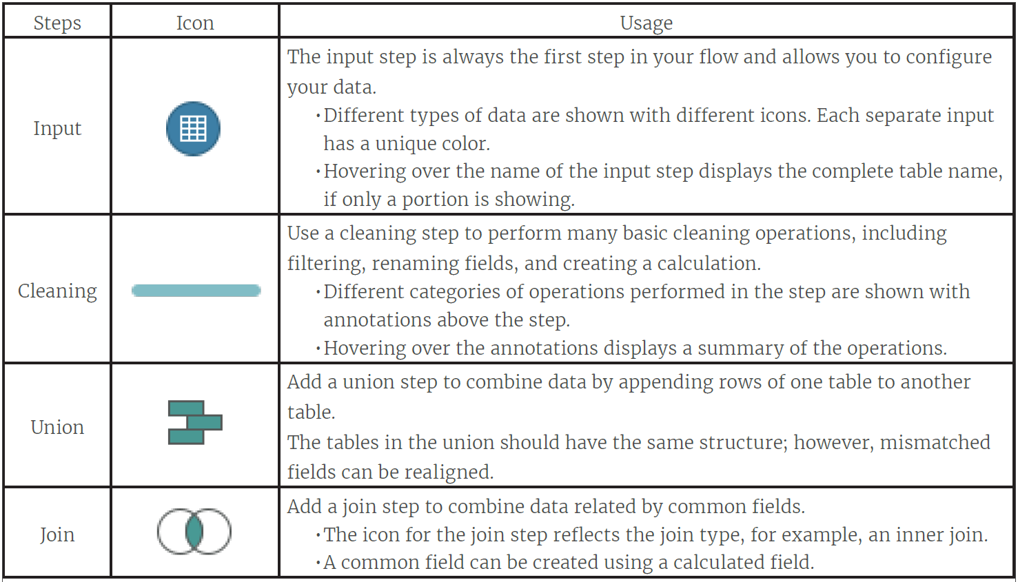
Types of Steps in a Flow

Slide 36
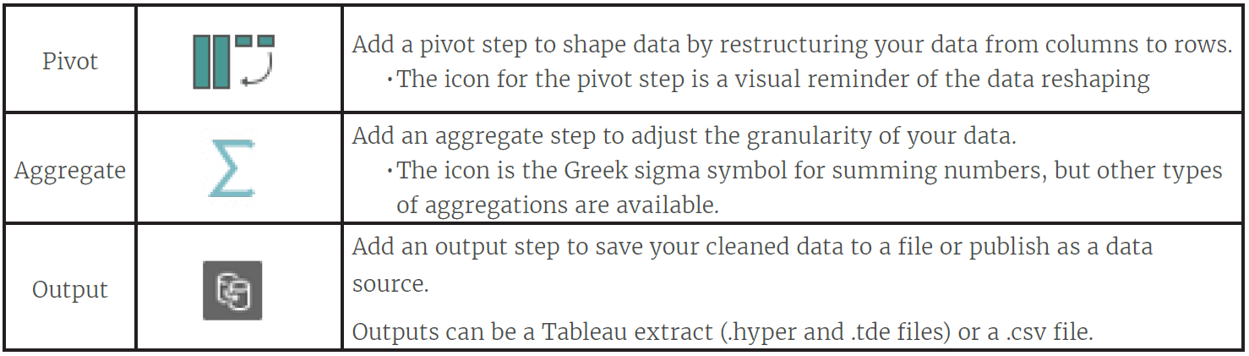
Types of Steps in a Flow (cont.)

Slide 37
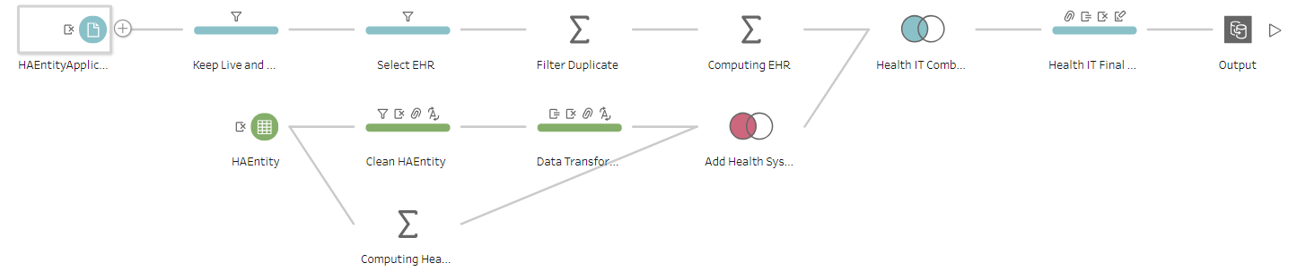
Hands-on Practices
(Self-Study, Introductory) Tableau Prep Free Training Video: https://www.tableau.com/learn/training#prep
https://www.tableau.com/learn/tutorials/on-demand/cleaning-step?product=tableau_desktop%2Btableau_prep&version=tableau_desktop_2019_3%2Btableau_prep_2019_3_1&topic=tableau_prep
(Self-Study, Introductory) Tableau Prep Help: https://help.tableau.com/current/prep/en-us/prep_whatsnew.htm
In-Class Demo: To give you a more hands-on experience and see how to work with real-world data, I use a very small part of my research project to demonstrate how we can use Tableau Prep in data processing (i.e., ETL process).

